Slide 1
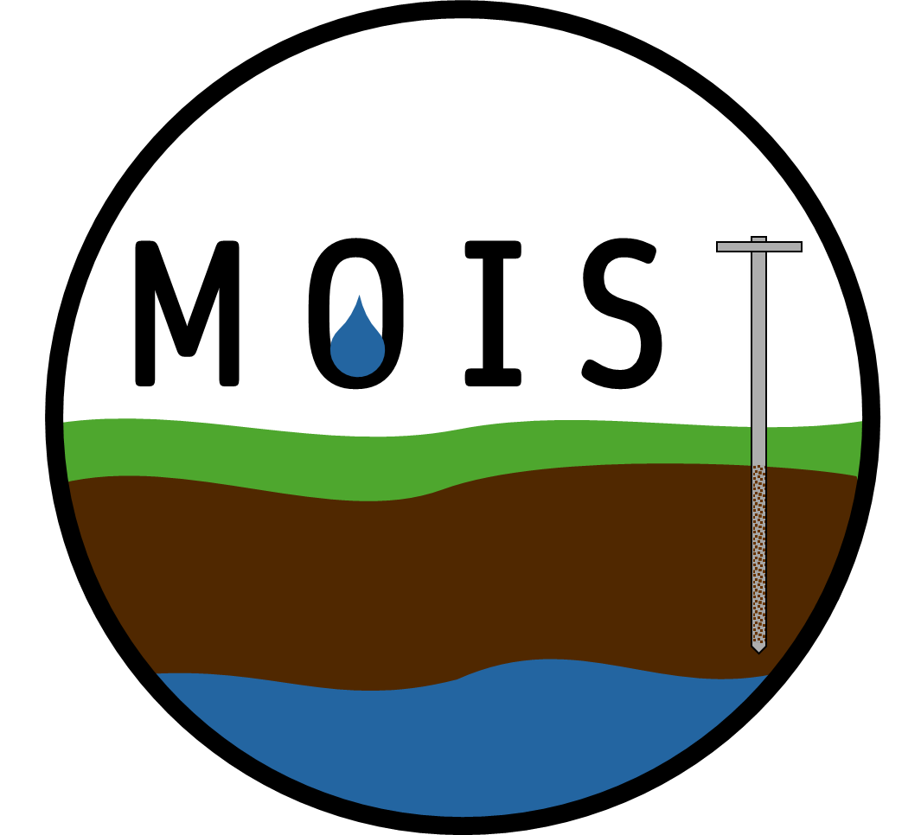






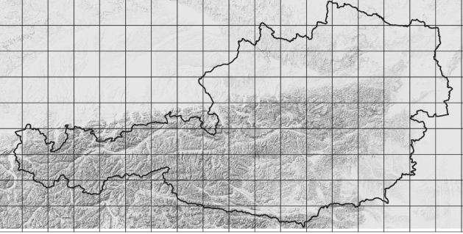


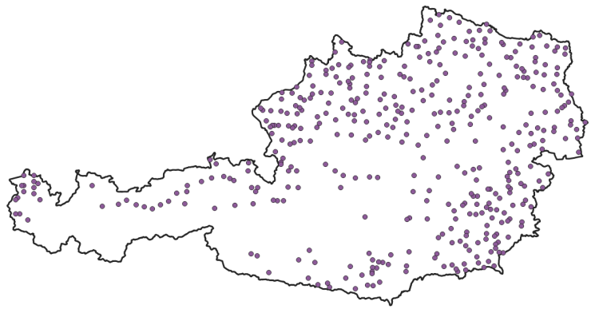
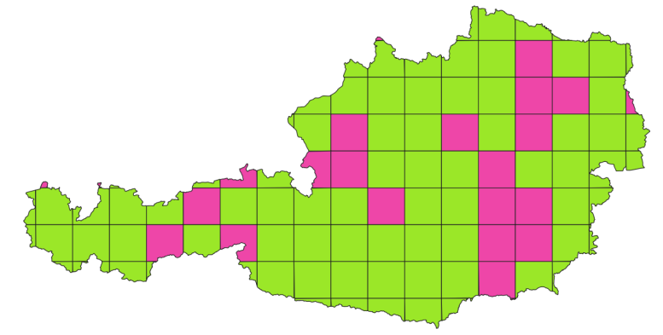
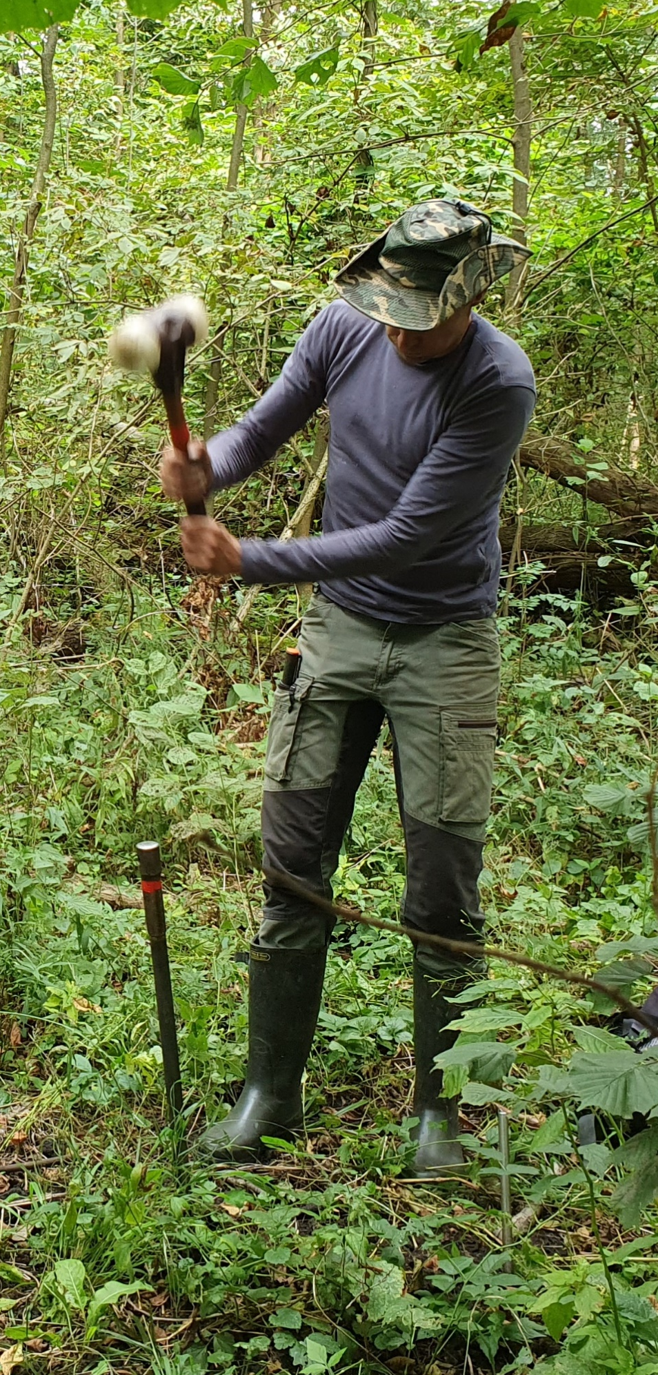
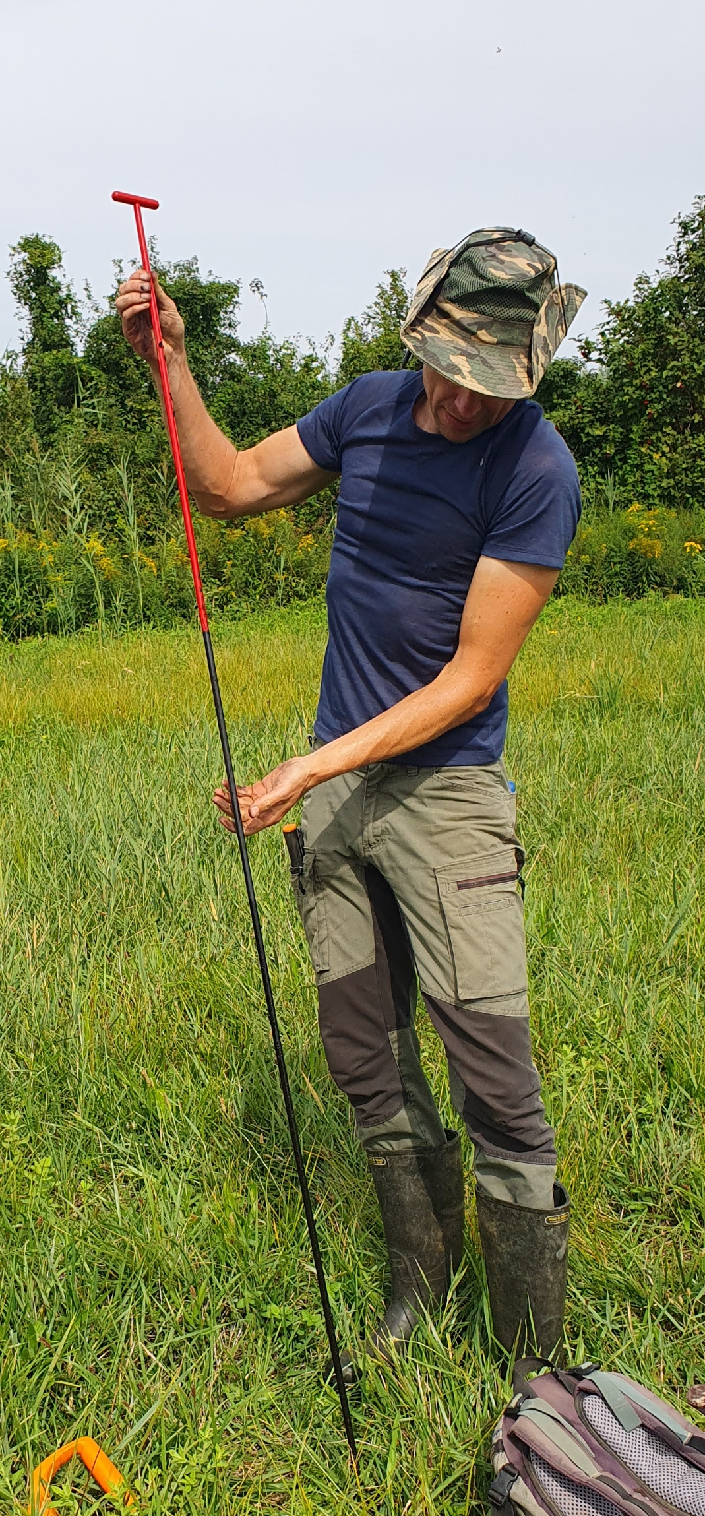
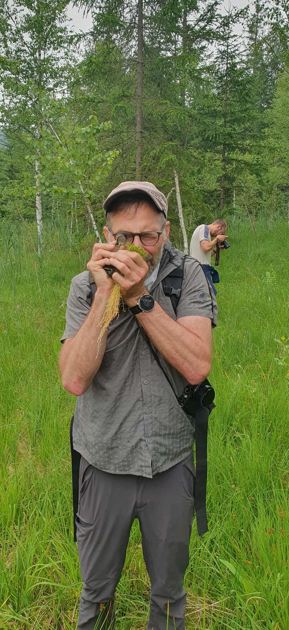
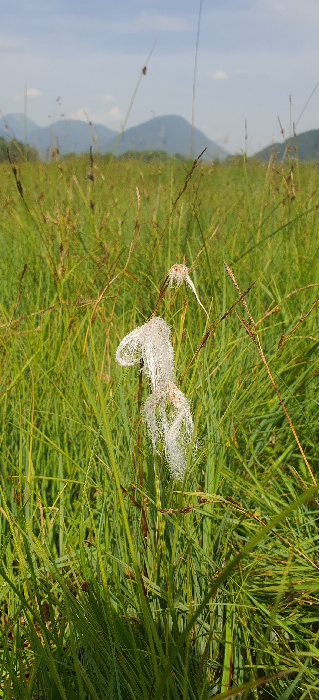
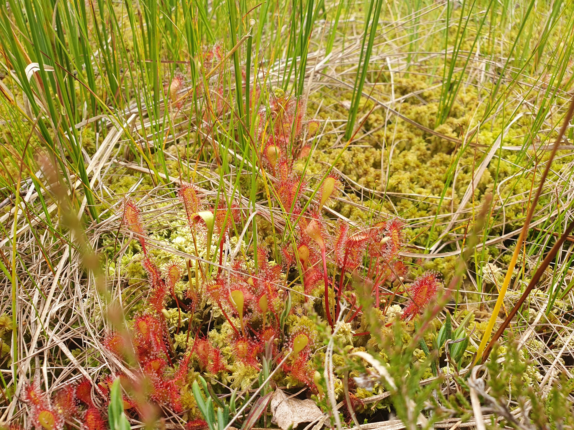
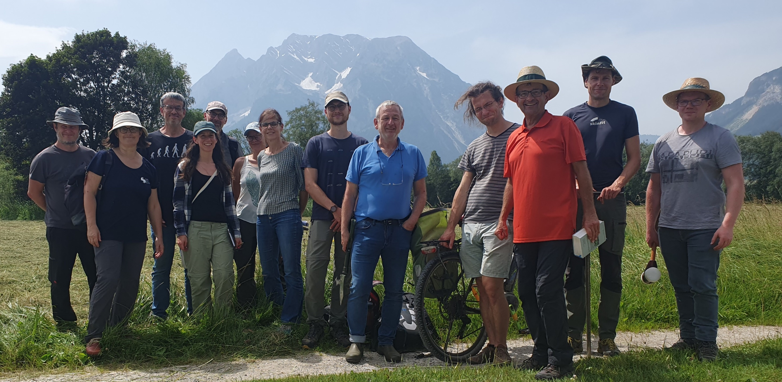
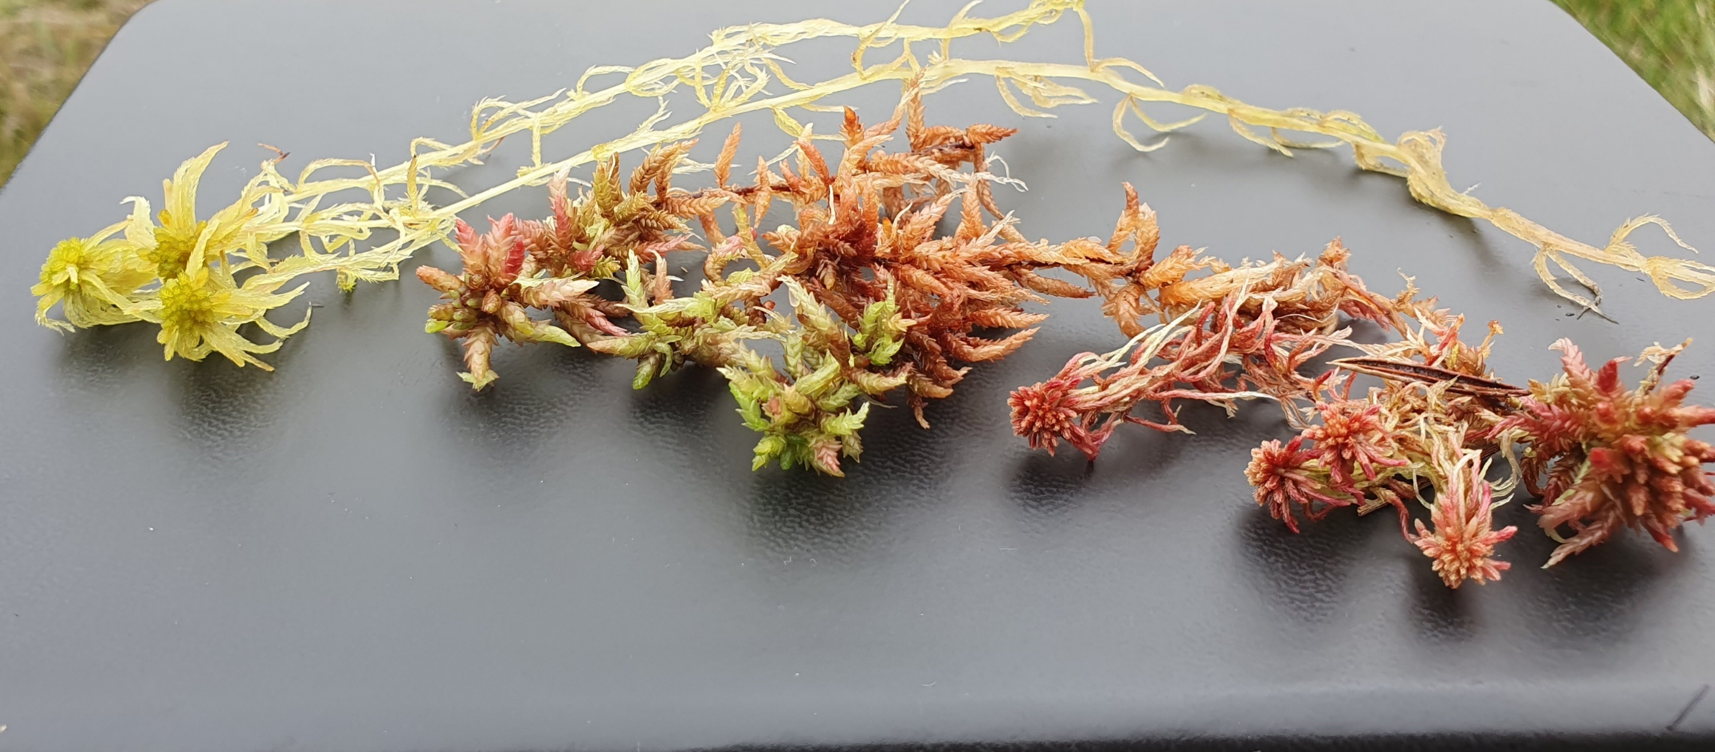
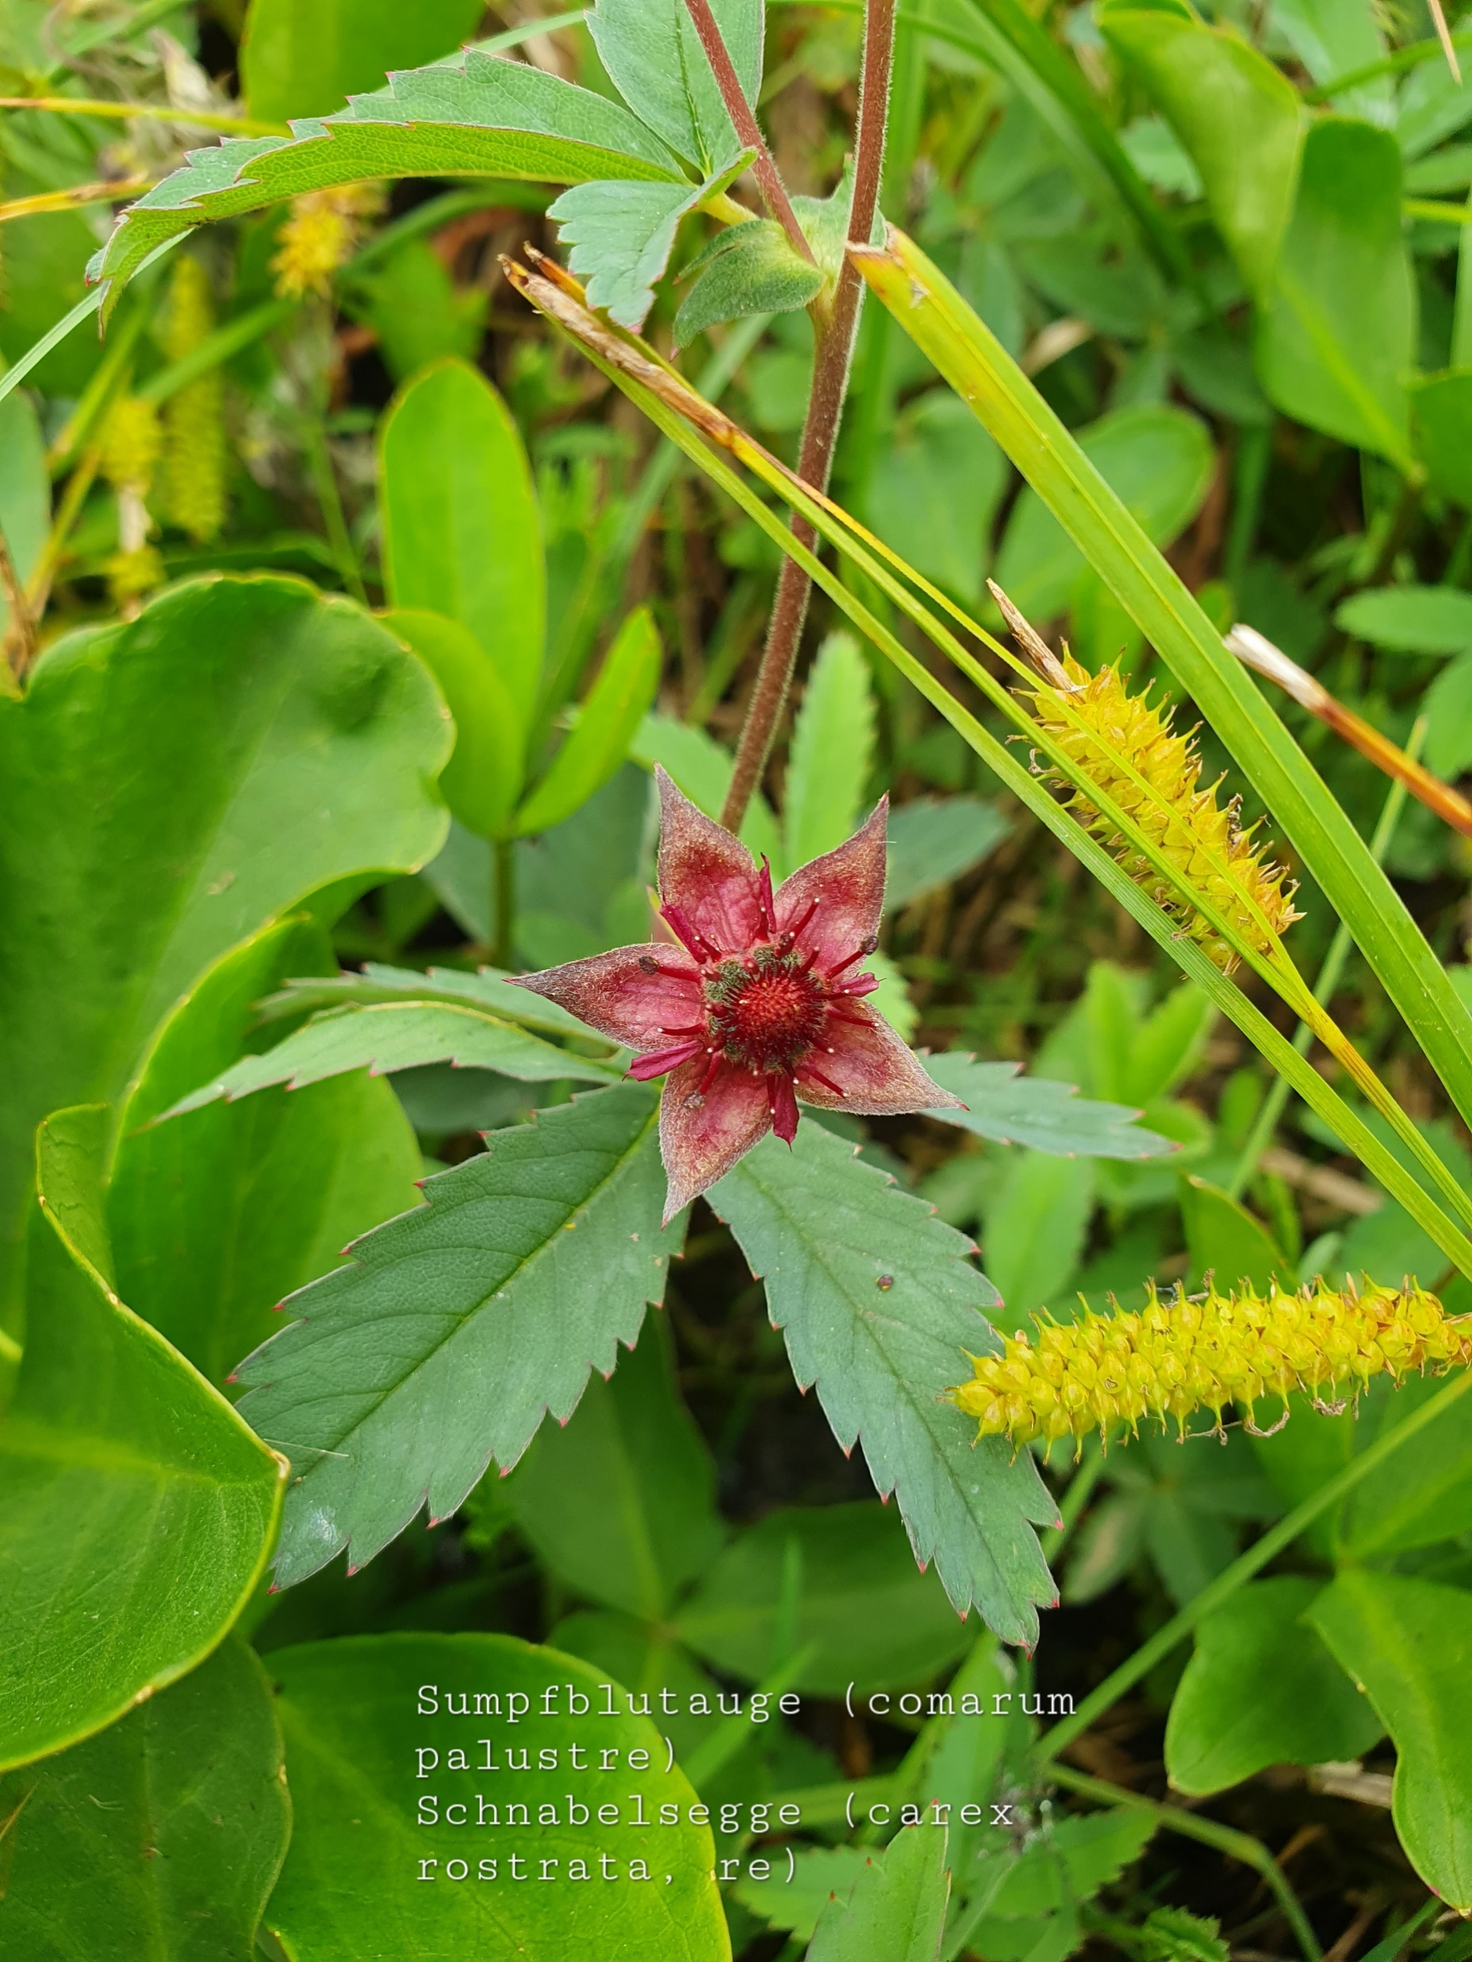
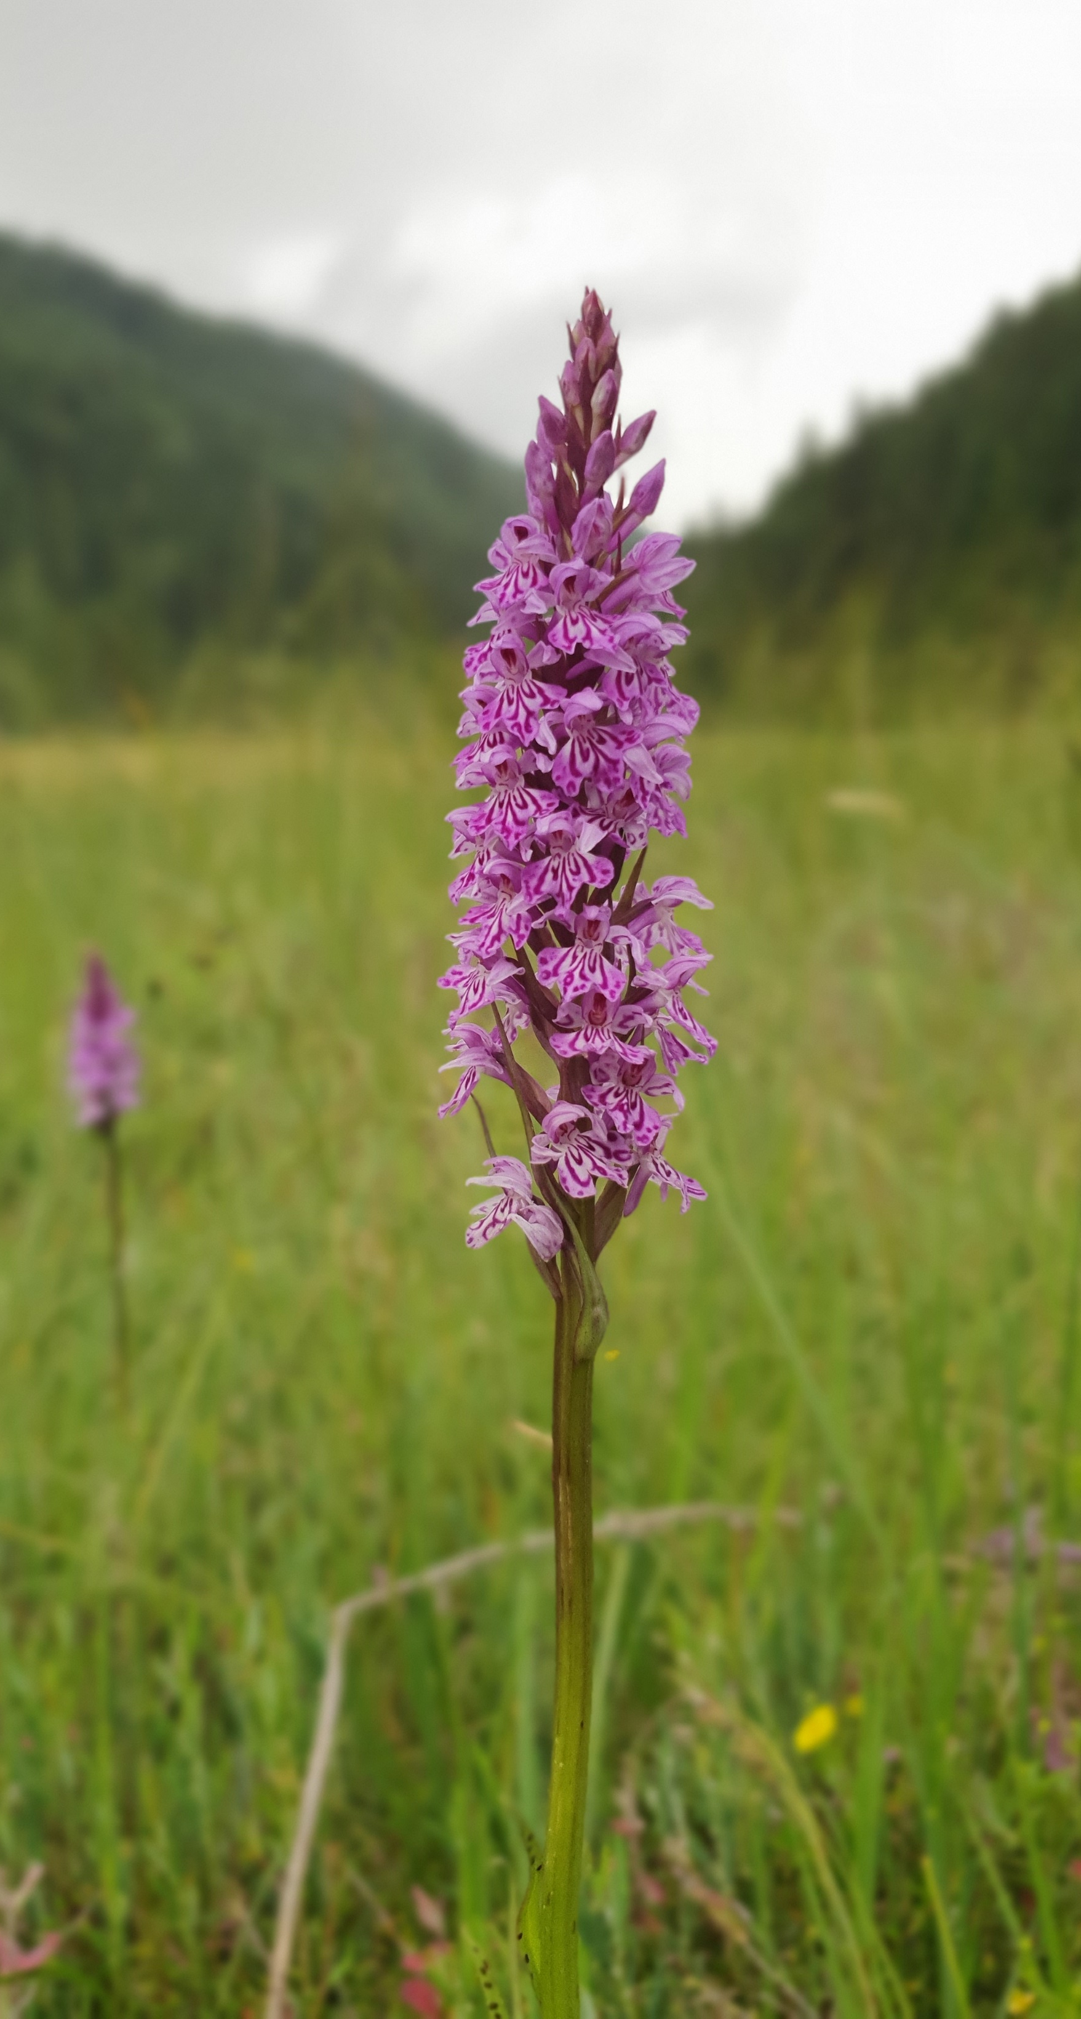
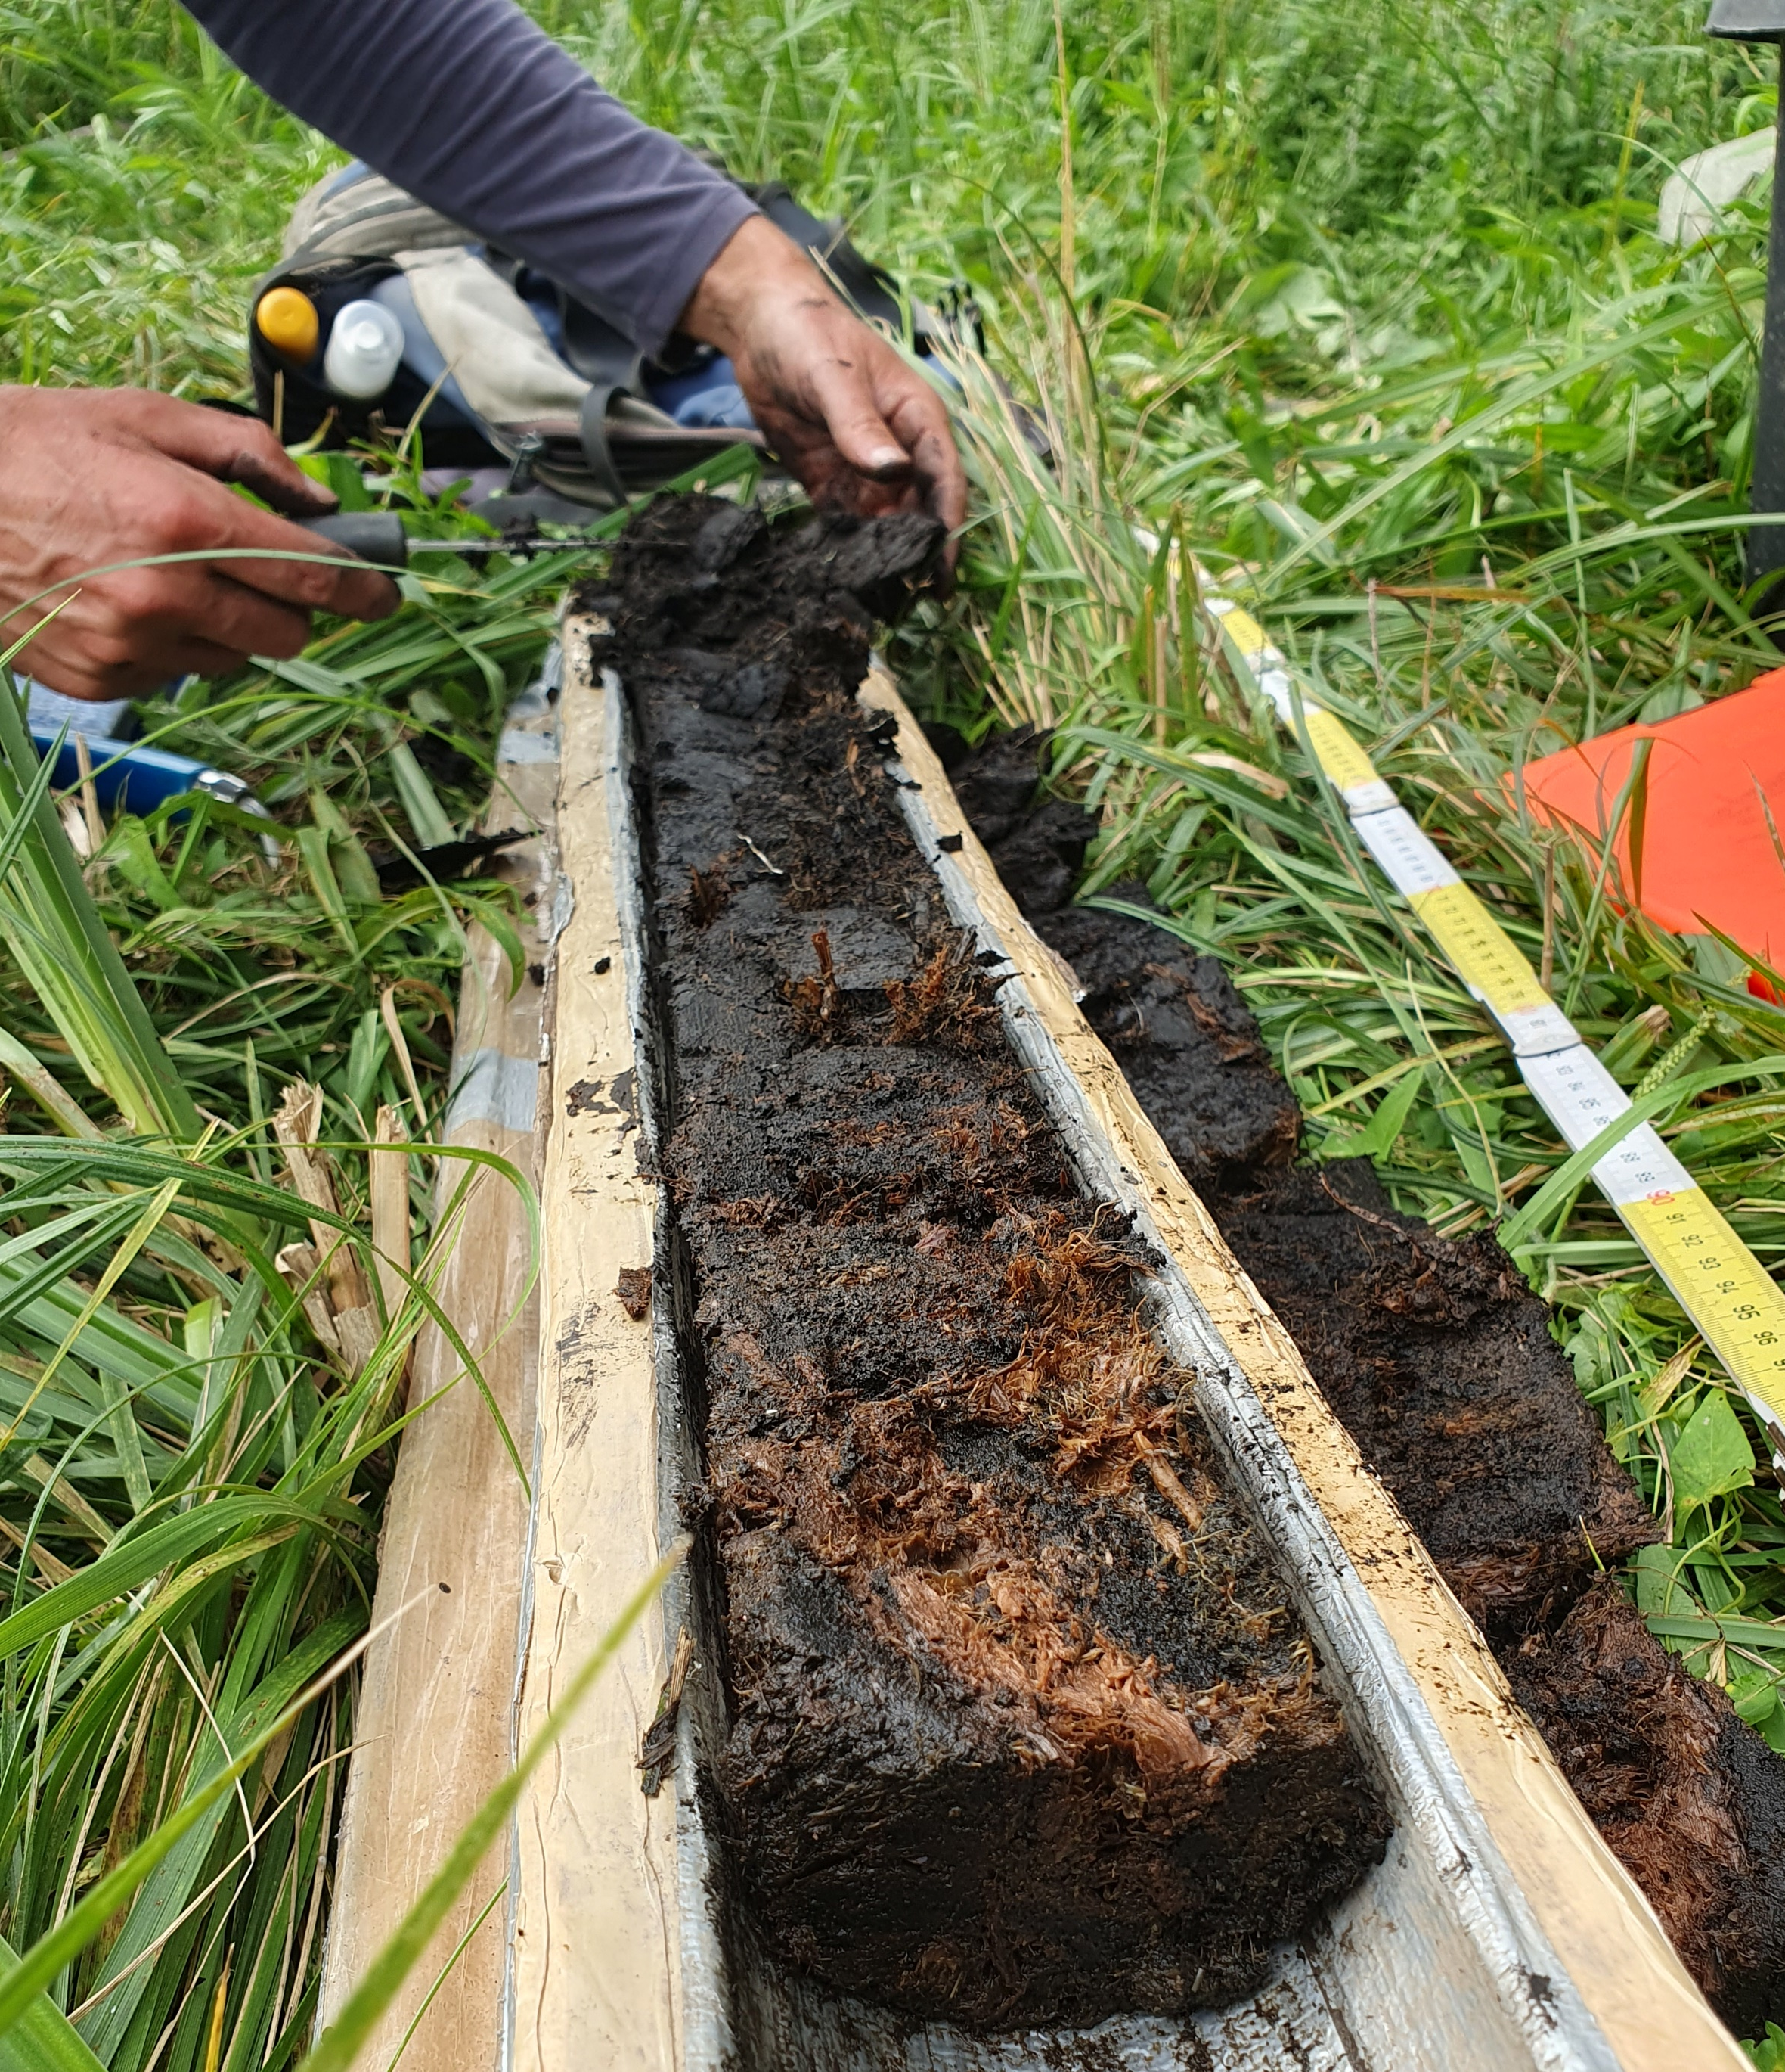
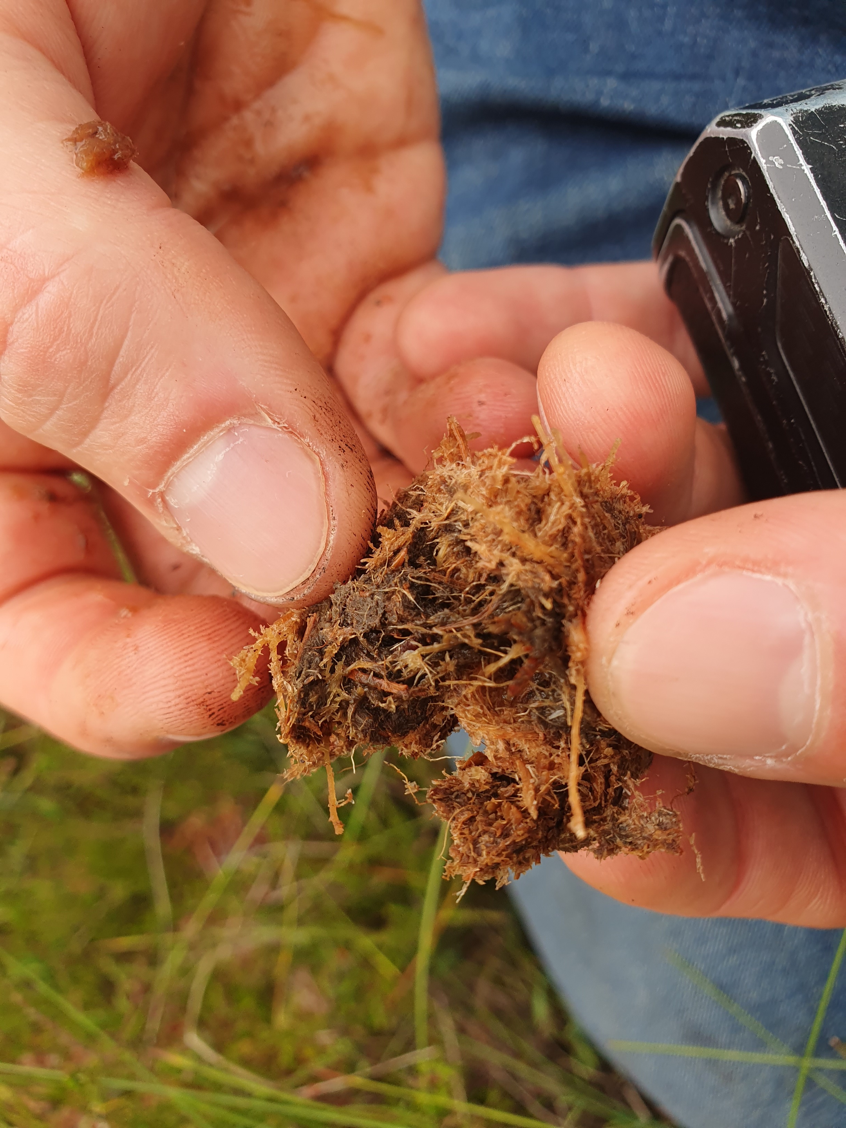






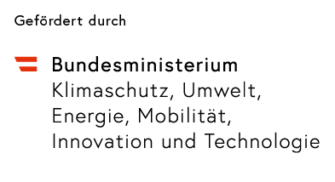
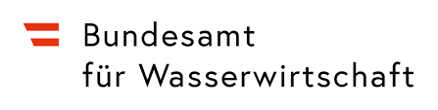


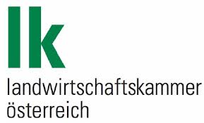


Hidden Peat – Identifying peat soils in Austria and evaluating their potential for restoration
Christina Hummel, Andreas Baumgarten, Günther Aust, Andreas Bohner, Thomas Brunner, Gerhard Egger, Michael Englisch, Stefan Forstner, Stephan Glatzel, Margit Gross, Hans-Peter Haslmayr, Elias Kapitany, Raphael Müller, Roman Portisch, Christian Rodlauer, Axel Schmidt, Marcel Schwarz, Michael Schwarz, Michael Weiß, Thomas Weninger, Thomas Wrbka
christina.hummel@ages.at
The problem
In Austria almost 90% of former peatland is drained.
Climate mitigation Biodiversity (habitat)
Rewetting & restoring initiatives
Nature Restoration Law, Austrian Biodiversity Strategy 2030, Austrian Peatland Strategy 2030+, IPCC
Research gap
Knowledge on the location of peatland, its degradation status and suitability for restoration is very incomplete
  Surveys are outdated
  Few data on peat soil forests & mountainous areas
Method
  Collect existing information
    Maps (e.g. eBOD, organic soils of GHG survey, soil survey of the ministery for finances, Moorschutzkatalog, drainage systems)
    Point data from projects (for better description and delineation of peatlands, PeatGovA., LUCASSAII, Wiederherst.d.Biodiv, in Mooren, Forsite, BORIS,…)
  Find and evaluate remote sensing data as predictor variables (e.g. climate, vegetation, hydrology, topography, parent material)
CO₂
Data Consolidation
  Species Distribution Modelling/Environmetal Niche Modelling
    Machine learning models for fens, transition mires, bogs, Anmoors, other peatland, other organic soils
    Models based on data about the occurrence of peatland, which is explained by predictor variables. Extrapolation to find unkown peatland.
    Resolution 10x10 m
Modelling
Research Questions
Where do we find peatland?
Where are suitable areas for successful and sustainable restoration?
How large is the area?
  Soil survey
    Development of a survey method for the description of soil & vegetation incl. hydrology, land use, biotope type
    Transects at 100 statistically selected areas
    Delineation and validation of the map of predicted peatland, data collection in data bank
Map Validation
Objectives
Map of intact and degraded peatland in AT
Probability map of unkown peatland
Map showing potential areas for restoration
Survey methods and data entry for degraded peatland
Evaluation scheme for an assessment of the degradation status and the suitability for restoration
  Development of criteria to describe the degradation and suitability for restoration
    10 case studies: detailed field survey on status, potential development indicators & scenarios and their social benefit (climate, biodiversity, productivity)
  Development of a scheme for prioritising areas that are suitable for restoration, considering pedological, hydrological and nature conservation aspects, possible opportunity costs in terms of agricultural productivity
  Involvement of stakeholders & experts
Soil description: Pürckhauer, hollow drill & avalanche probe (for peat layer thickness)
Evaluation of Degradation & Restorability
Vegetation description: 10 most prevailing plants & their Ellenberg indicator values (moisture, nutrients/Nitrogen, …)
Benefits for Austria
Basis for long-term monitoring of peat soils, their degradation and restoration
Basis for decisions on restoration/rewetting or sustainable use (e.g. common agricultural policy measures)
  GIS analysis for the development of a map highlighting areas likely suitable for rewetting
  Definition of the total area of peatland suitable for rewetting
Suitability Map
Endangered plants such as Sundew (Drosera)
Dieses Projekt wird durch den Biodiversitätsfonds des Bundesministeriums für Klimaschutz, Umwelt, Energie, Mobilität, Innovation und Technologie gefördert.

